Slide 1

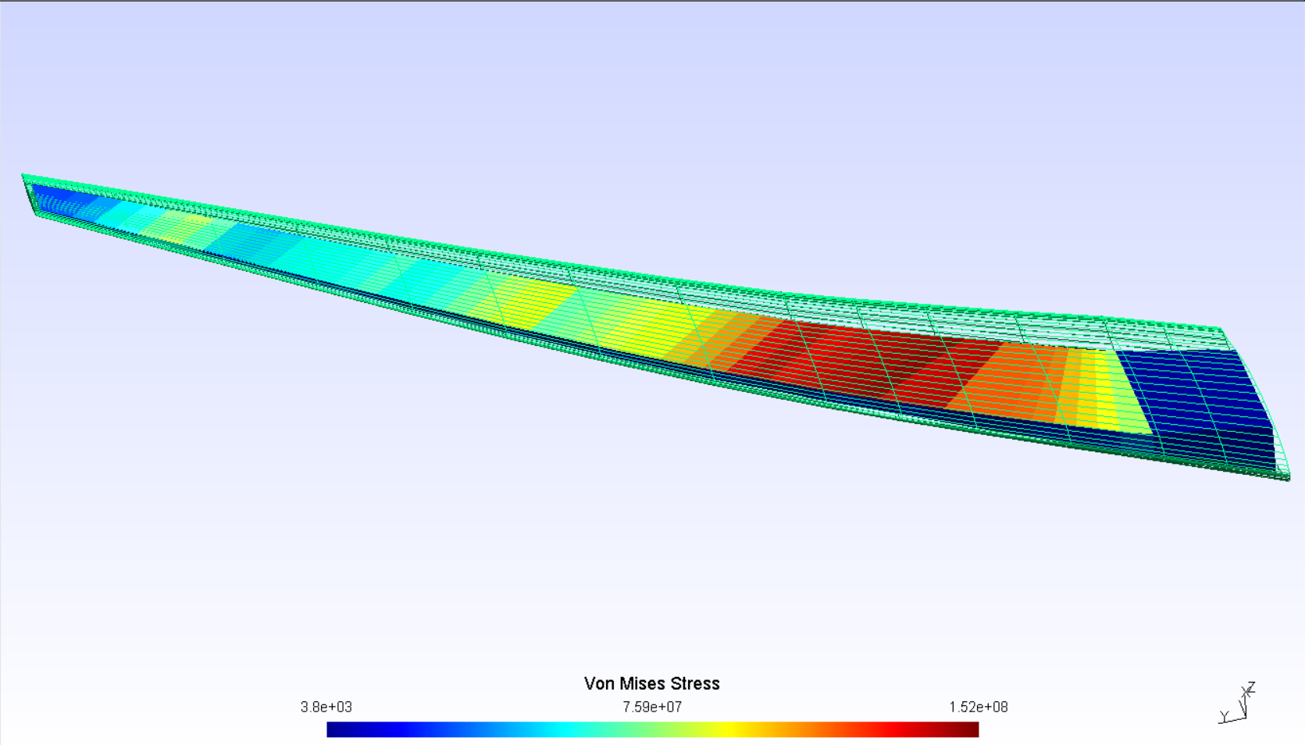
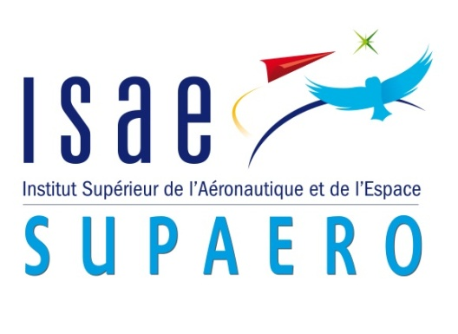
Multifidelity aeroelastic optimization with application to a BWB.
Gilberto RUIZ JIMÉNEZ¹;
Joan MAS COLOMER; Joseph MORLIER
1,2: ISAE-SUPAERO, Université de Toulouse, France 3: ICA, ONERA, France
1. gilberto.ruiz-jimenez@student.isae-supaero.fr
1. Introduction
3. Preliminary Results
Aerospace design requires the consideration of fluid-structure interaction from the early stages of the project. MDO libraries allow the user to couple both disciplines and optimize with respect to established bounds and variables [1].
High-Fidelity simulations offer accurate results but are often too expensive for direct design optimizations.
Low-Fidelity analysis offer reasonable approximations with low computational demands.
Multifidelity methods leverage error and costs to speedup simulations [2]. The purpose of this work is to implement the aforementioned techniques to the development of a BWB concept aircraft.
After successfully linking both fidelity methods via the displacement field, different iteration limits were set at the Lo-Fi levels to evaluate the evolution of the total execution time for the sample problem. Fig. 2 shows the combination of iterations required for convergence of the linked MDA as well as the time to converge.
This plot suggests that accelerating the process is possible and further experimentation will be carried out to go from an iteration-based control to a residual-based control for optimum performance. The resulting shape and stress field is similar for all cases (Fig. 3).
4. Project Milestones
2. Proposed Method
Write the code that connects both fidelity levels in OpenMDAO.
Run the multi-fidelity optimization for the sample case.
Check performance of the new proposal vs. previous code and single fidelity.
Apply the method to a BWB configuration and validate the results.
Check for possible performance improvements for the complex case.
The main base for the development of this project is the aerostructures python package [3], which facilitates the creation of MDA and MDAO problems in OpenMDAO.
Open-source structural (NASTRAN) and fluid solvers (Panair, ADFlow) are coupled via the displacement field of the structure, and then optimized with respect to the induced drag (see Fig. 1).
At this stage, the same solver (Panair) is used for both fidelities and the only difference between then is the size of the fluid mesh. The philosophy behind this temporary choice is to build a progressively complex model, making sure that everything works at each step.
Root_Optimizer (CDi)
[1] Gray, J., Moore, K., & Naylor, B. (2010, September). OpenMDAO: An open source framework for multidisciplinary analysis and optimization. In 13th AIAA/ISSMO Multidisciplinary Analysis Optimization Conference (p. 9101).
[2] Peherstorfer, B., Willcox, K., & Gunzburger, M. (2018). Survey of multifidelity methods in uncertainty propagation, inference, and optimization. SIAM Review, 60(3), 550-591.
[3] Mas-Colomer, J. (2018). Aeroelastic Similarity of a Flight Demonstrator via Multidisciplinary Optimization (Doctoral dissertation, Université Fédérale de Toulouse).
MDA_Lo-Fi
Displacement
Field
Structural
Solver
Displacement
Transfer
Aerodynamic
Solver
Load
Transfer
MDA_Hi-Fi
Structural
Solver
Displacement
Transfer
Aerodynamic
Solver
Load
Transfer
Filter
Fig. 3 Equivalent stress over an optimized wing .
Fig. 2 Performance plot of the current MDA multifidelity system.
Fig. 1 MDAO Diagram for the multifidelity scheme.

